Slide 1
Rescue-feet
Gesture Controlled Hexapod with Live stream for rescue operations
Team 8: Archit Sharma, Sai Pranay, Samyu Kamtam

Slide 2
Contents
Problem statement
Features
Advantages and disadvantages
Design
System flow chart
Mathematics
Hexapod integration
Prototype
Practical Overview
Related work
Applications
Innovative features and Unique selling proposition
Cost analysis
Next steps and Conclusion

Slide 3
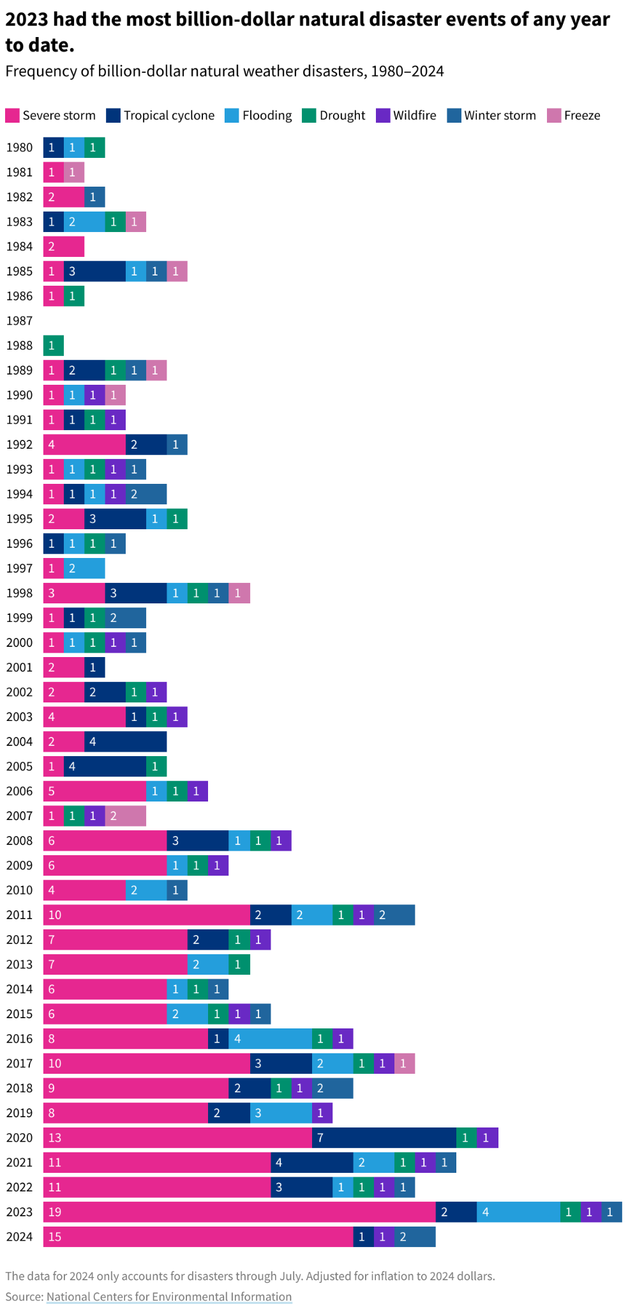
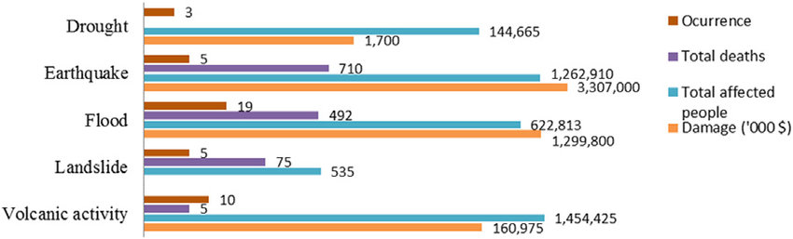
Problem Statement
The increasing frequency and severity of natural disasters make traditional search-and-rescue operations challenging due to hazardous conditions and inaccessible terrain.
Rescue robots provide a critical solution by enhancing response efforts, navigating dangerous environments, and locating survivors more efficiently, ultimately improving disaster relief and saving lives.

Slide 4
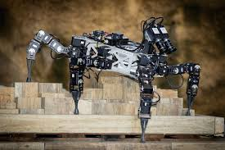
Features
Six-legged locomotion provides stability in rough terrain navigation
Gesture control for remote and convenient operation
Real-time video streaming with ESP32-CAM
Modular design for flexibility and upgrades

Slide 5
Advantages
Disadvantages
Enhanced mobility
Remote controlled operation
Stability and redundancy
Real time video streaming
User-friendly
Modular & scalable design
Complexity (Design and control)
Cost
Energy consumption
Connectivity issue
Payload limitations

Slide 6
Design

Slide 7
Working
Actuate
Servo states outputted as PWM signals to servos for actuation.
03
Sense (peripherals)
Using camera live stream to view the scene of the disaster.
01
02
Controls
User controls hexapod through gesture control and sends signal using ESP NOW protocol.

Slide 8

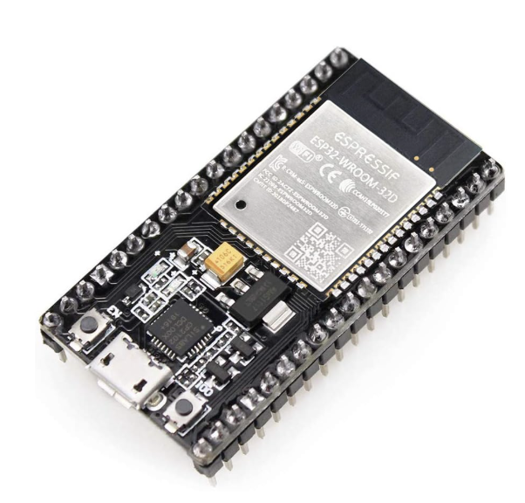

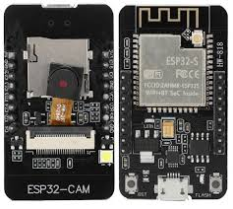
System flow chart
User-control
Gesture control for navigation using flex sensor and Memsic accelerometer.
Propeller
Gait calculation for servo control
Via ESP-NOW
ESP32 Wroom 32
Power regulator for Arduino and ESP-32
Hexapod
Hexapod locomotion with appropriate servo movement.
Esp-32
Live stream of hexapod view for accurate navigation.

Slide 9
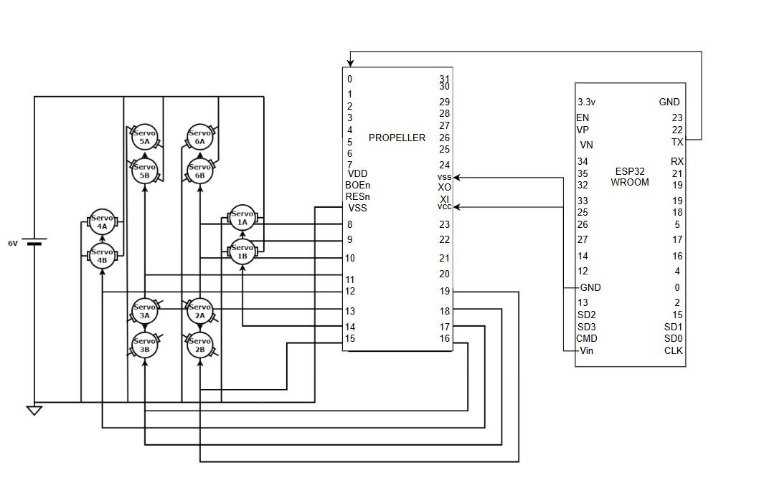
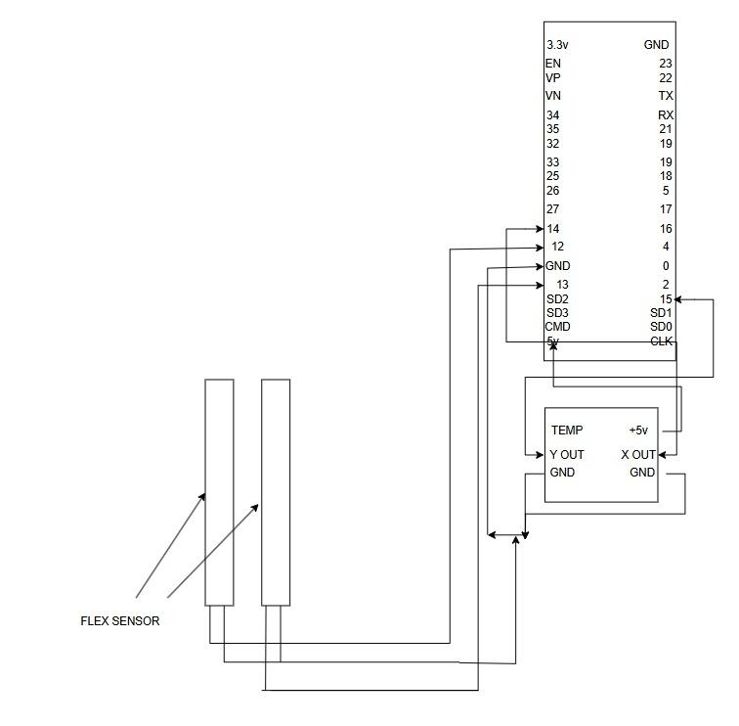
Electronic circuit diagram
ESP32 Wroom 32
Hexapod
Gesture control

Slide 10
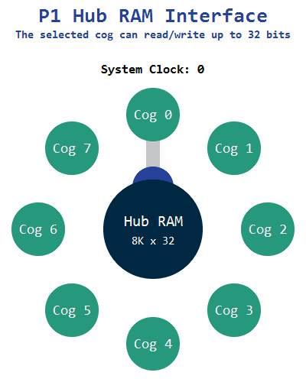
Multicore propeller process
Cogs 0-5 handle the PWM signals to each of the legs of the hexapod.

Slide 11
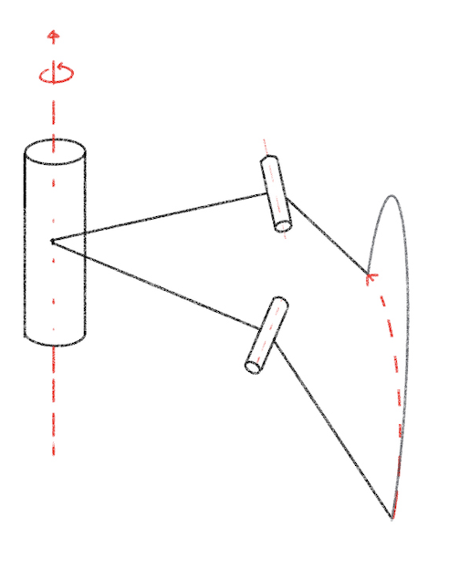
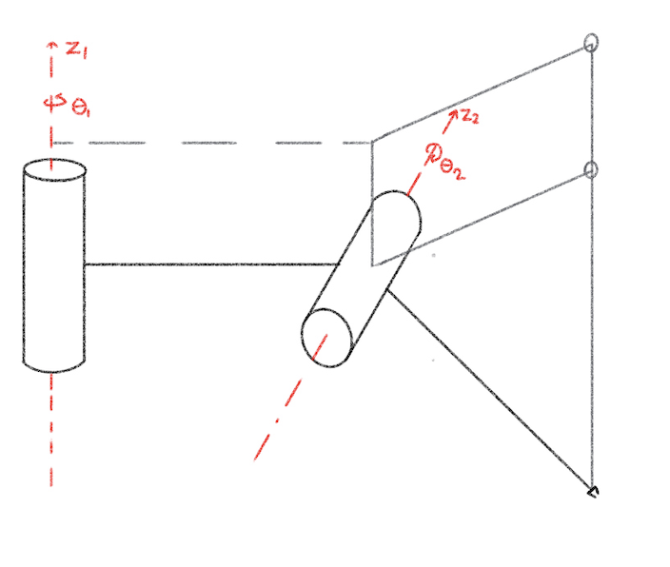
Working of hexapod
End Effector Coordinates:
𝑟 = 𝑎₁ + 𝑎₂𝑐𝑜𝑠(𝜃₂)
𝑙𝑜𝑐𝑎𝑙 𝜃 = 𝜃₁
𝛿 𝑧 = 𝑎₂ 𝛿 𝑠𝑖𝑛(𝜃₂)
Joint angle to Servo PWM signal:
𝑃𝑊𝑀 = (450/𝜋)*(𝜃-𝜋/2) +150

Slide 12
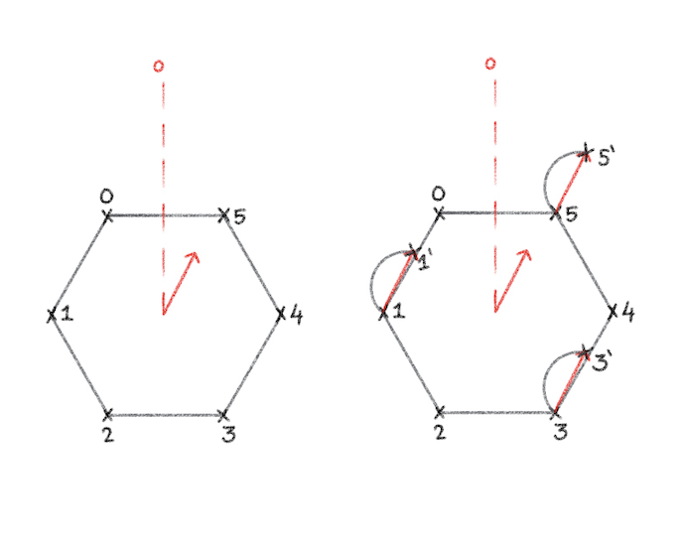
Gait algorithm
Group P : legs {1, 3, 5}
Group Q : legs {0, 2, 4}
1. P swing starts
2. Q assumes tripod
3. Q swing starts
4. P assumes tripod

Slide 13
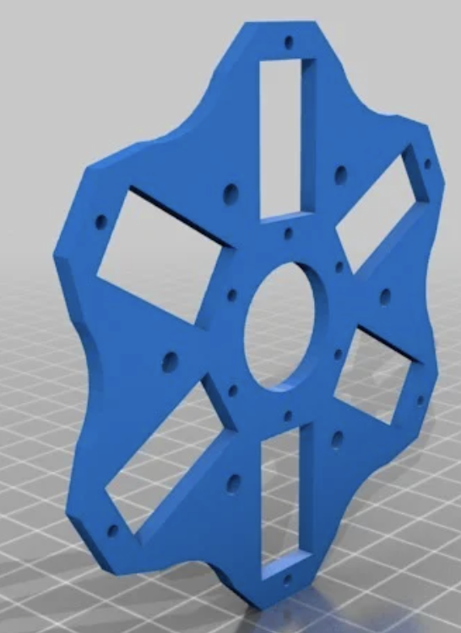
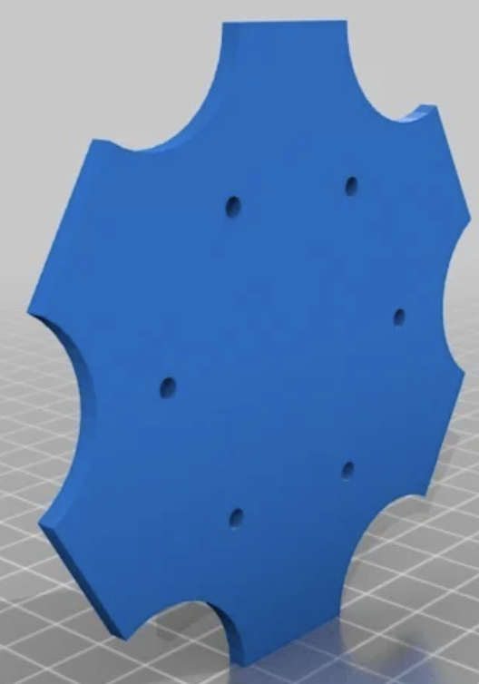
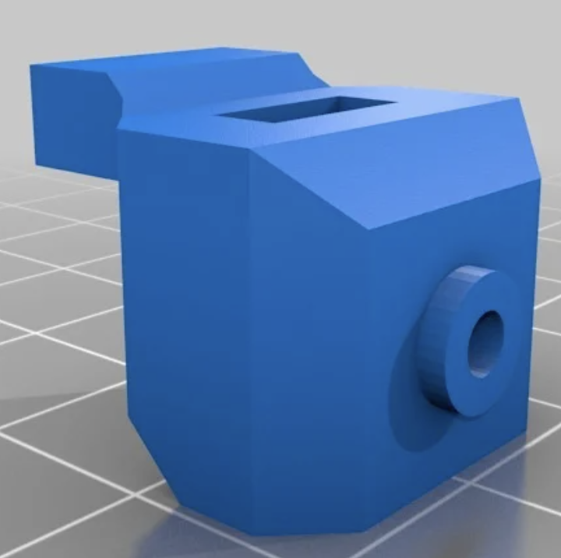
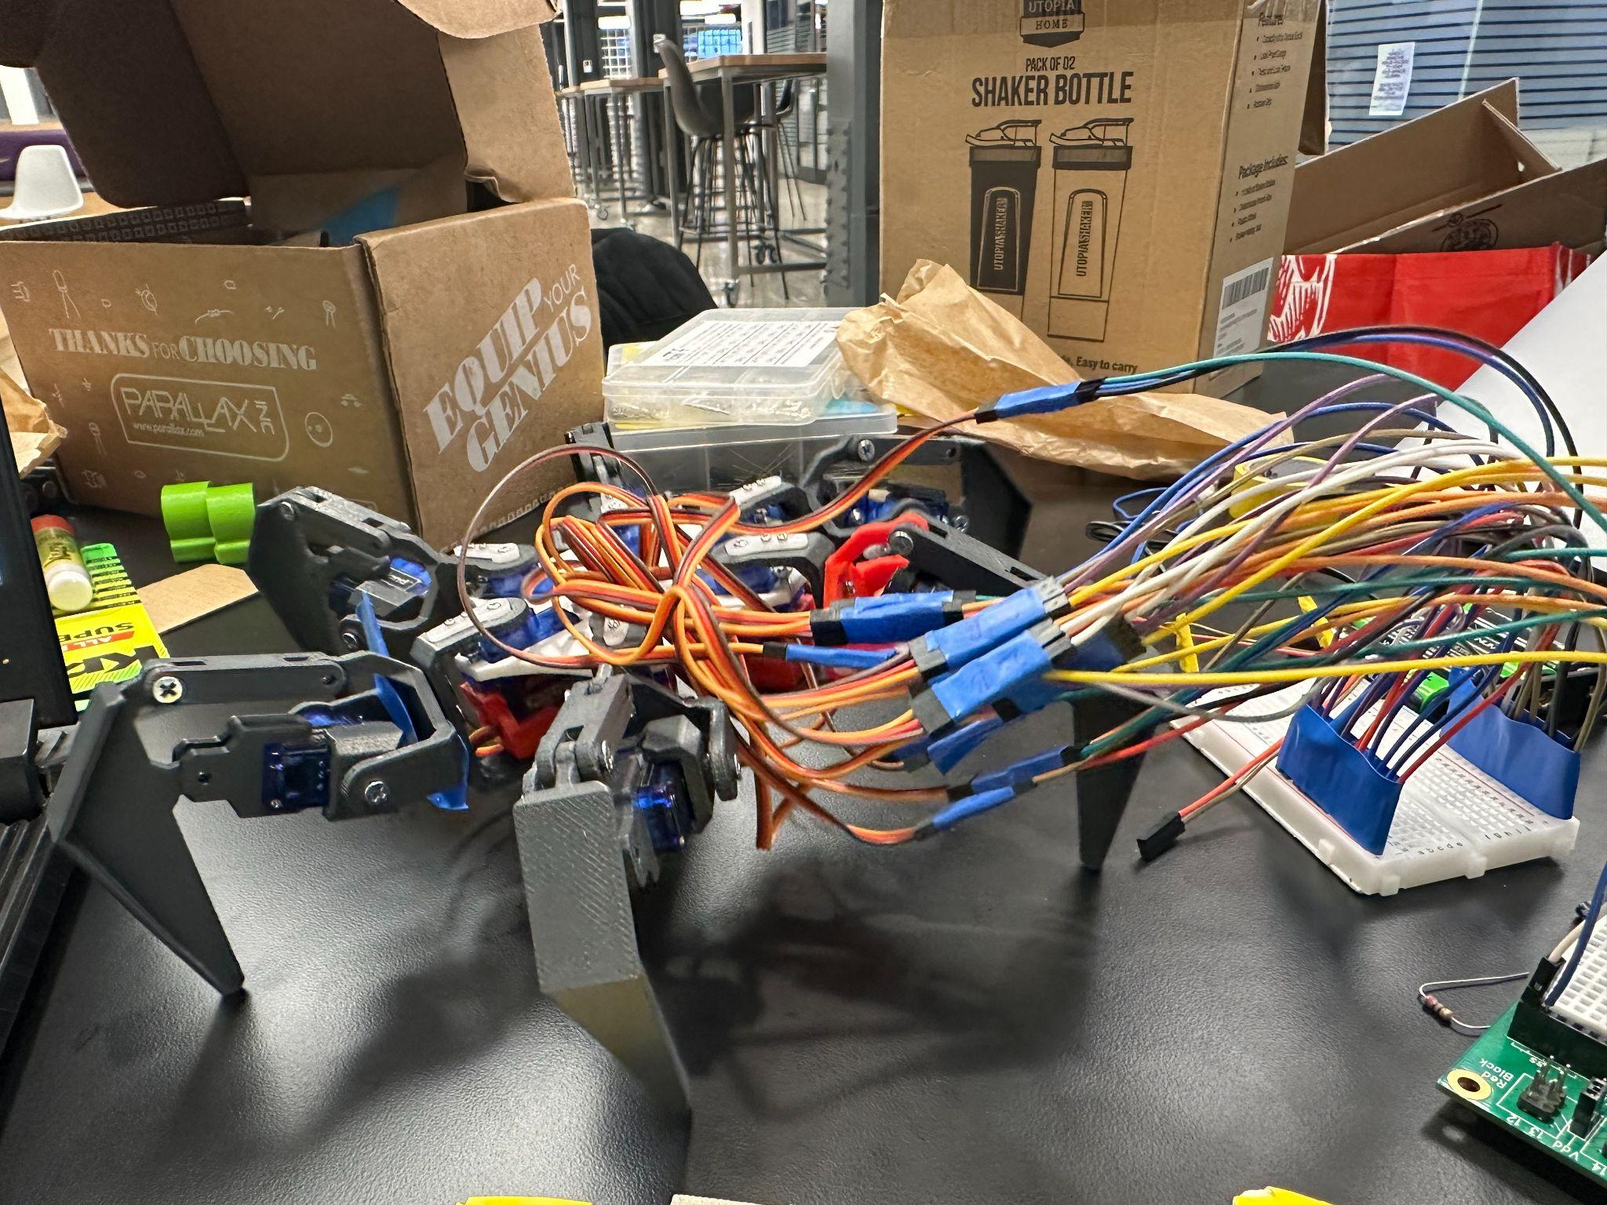
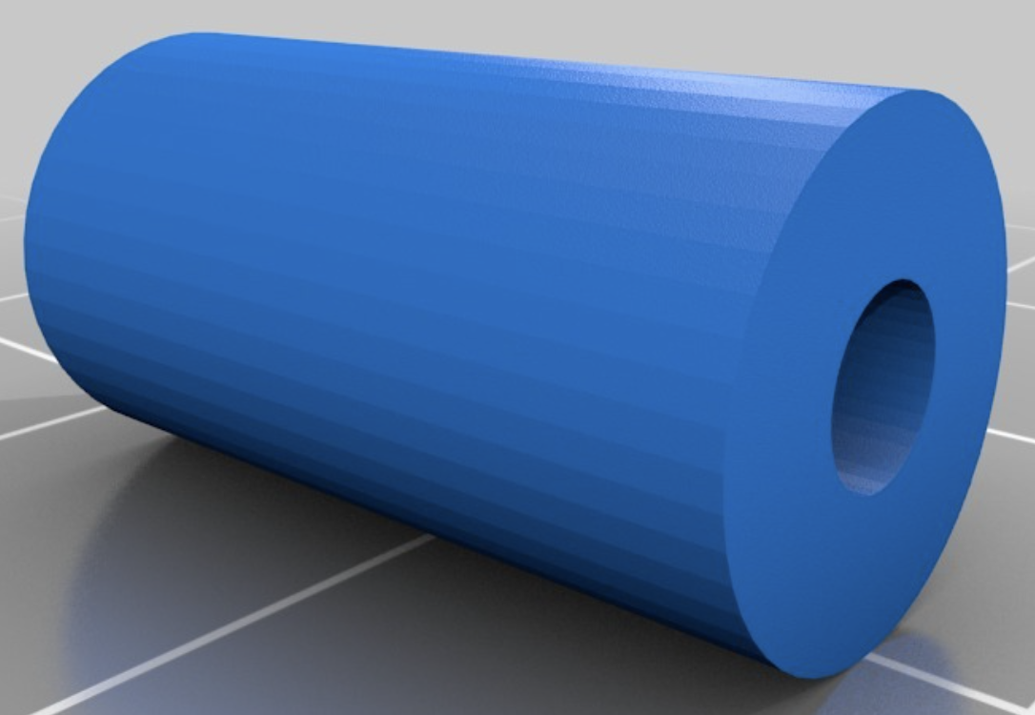
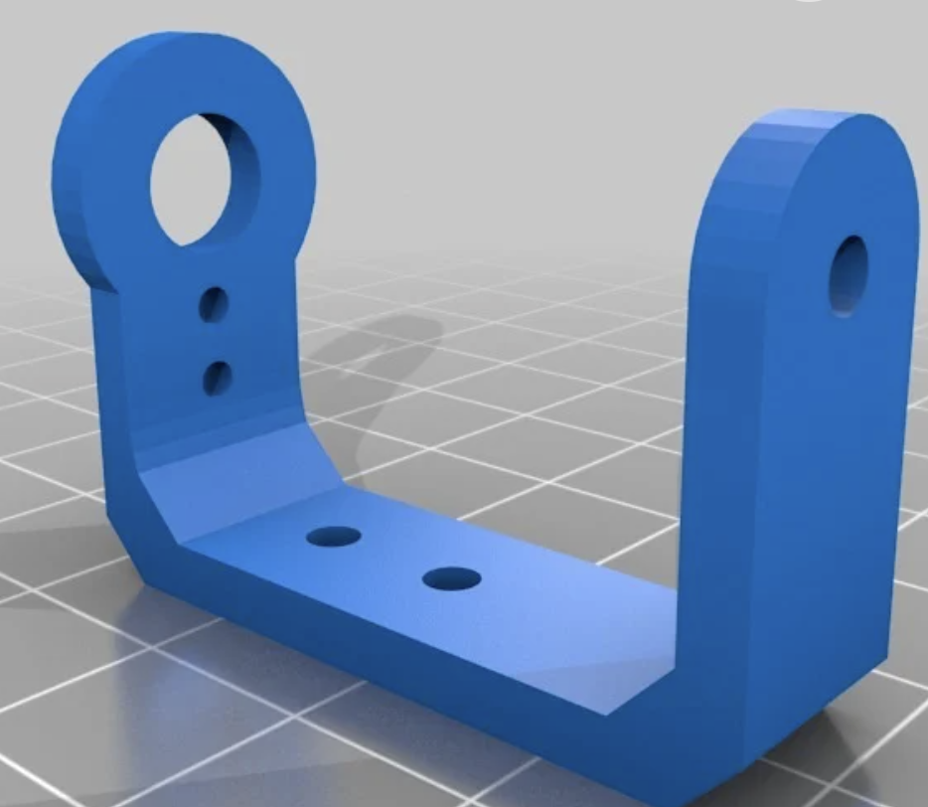
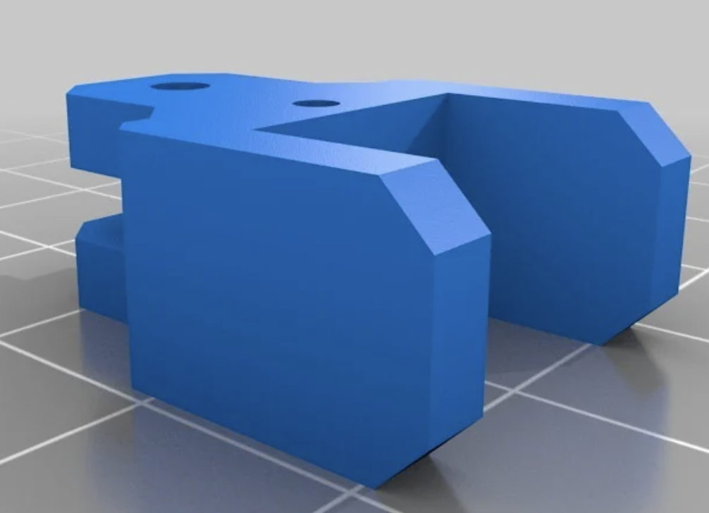
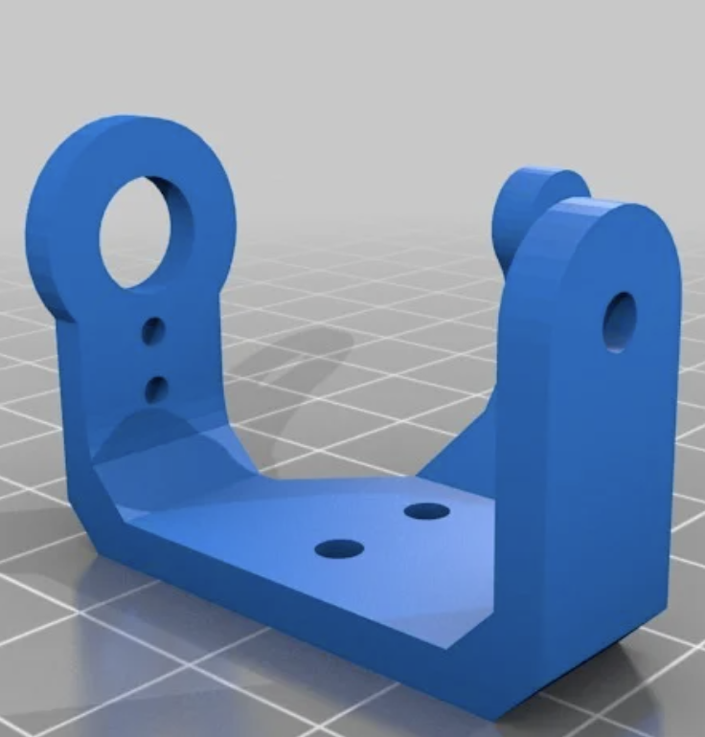
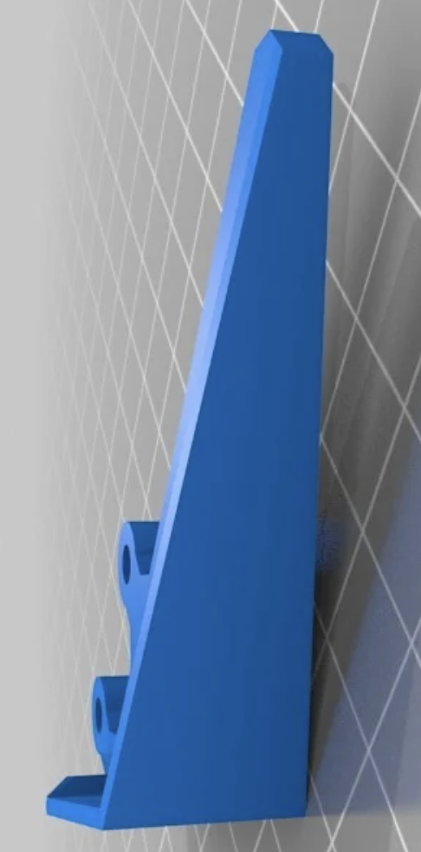
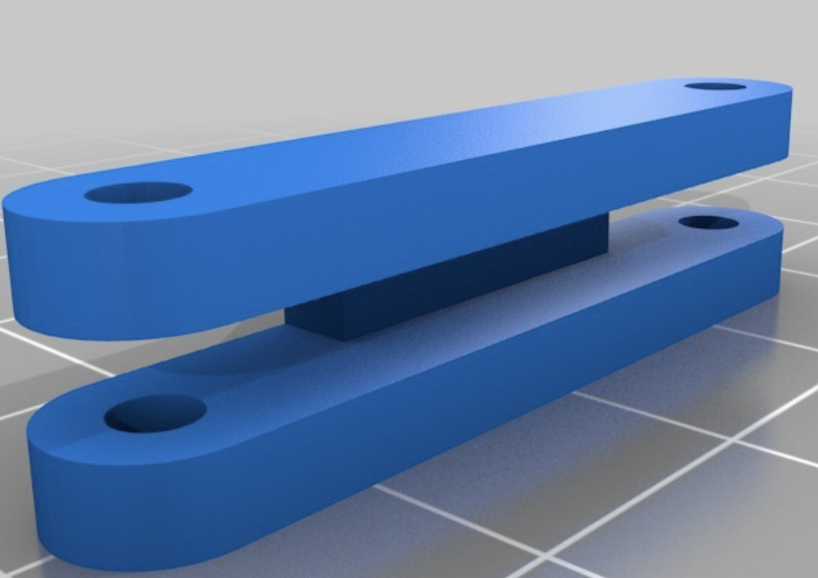
Mechanical Design - Hexapod
Supports
Hexapod
Lower base
Upper base
Servo Bracket
Leg Components

Slide 14
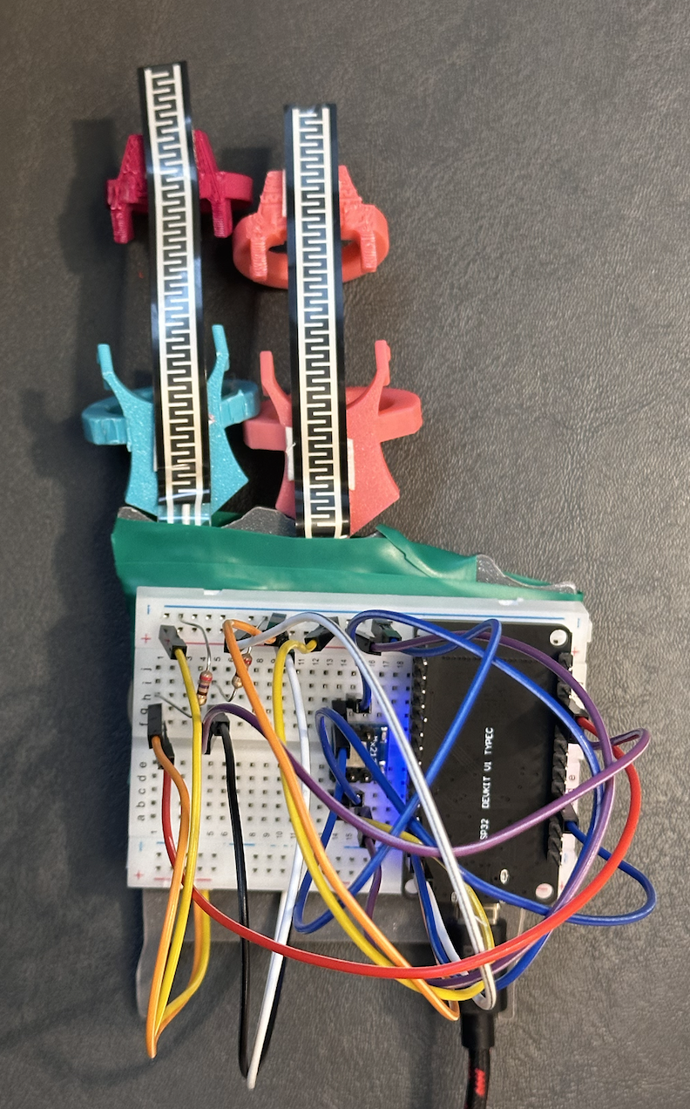
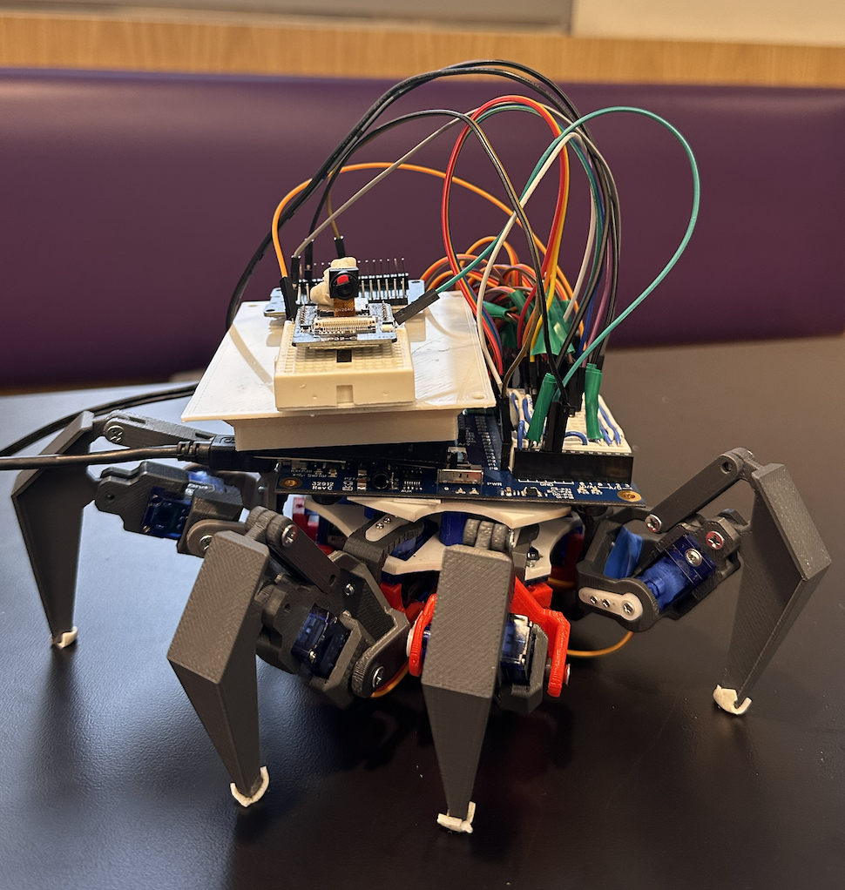
Hexapod integration
Gesture control
ESP32 Wroom 32
ESP32 Camera
Propeller
Servos
Flex sensors
Memsic Mx2125
ESP32 Wroom 32

Slide 15
Encoder logic
State = flex1*18 + flex2*9 + x*3 + y
Movement | Flex 1 (*18) | Flex 2 (*9) | X (*3) | Y (*1) | Encoded value | Final value
Idle | 0 | 0 | 1 | 1 | 4 | 1
Front | 1 | 0 | 1 | 1 | 22 | 2
Front right | 1 | 0 | 0 | 1 | 19 | 3
Front left | 1 | 0 | 2 | 1 | 25 | 4
Back | 0 | 1 | 1 | 1 | 13 | 5
Back right | 0 | 1 | 0 | 1 | 10 | 6
Back left | 0 | 1 | 2 | 1 | 16 | 7
Bounce | 0 | 0 | 1 | 0 | 3 | 8
Kill | 1 | 1 | 1 | 1 | 31 | 9

Slide 16
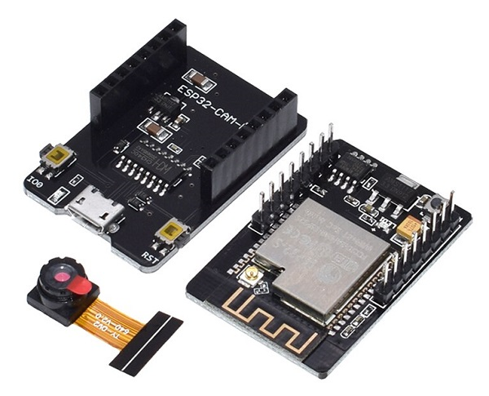
ESP-32 Camera
ESP32 Wroom 32
ESP-32 Camera
ESP32 Wroom 32
The ESP32 runs a lightweight HTTP server to stream images or live video.
Uses multipart MJPEG format to provide a continuous stream in a web browser
Brownout Protection: ESP32 has a brownout detector, which resets the device if power drops below the threshold.
Frame Buffering: Uses PSRAM (if available) to store images before sending them via WiFi.
Image Formats: Supports JPEG, RGB565, YUV422.
Dual-Core 240 MHz Processor with built-in Wi-Fi and Bluetooth (v4.2 + BLE) for robust wireless communication.
Multiple Interfaces: Supports UART, SPI, I2C, PWM, ADC (12-bit), DAC (8-bit), and capacitive touch.
Low Power Modes: Includes deep sleep and brownout protection for battery-efficient applications.
Flexible Firmware Support: Compatible with Arduino, ESP-IDF, MicroPython, and PlatformIO environments.

Slide 17
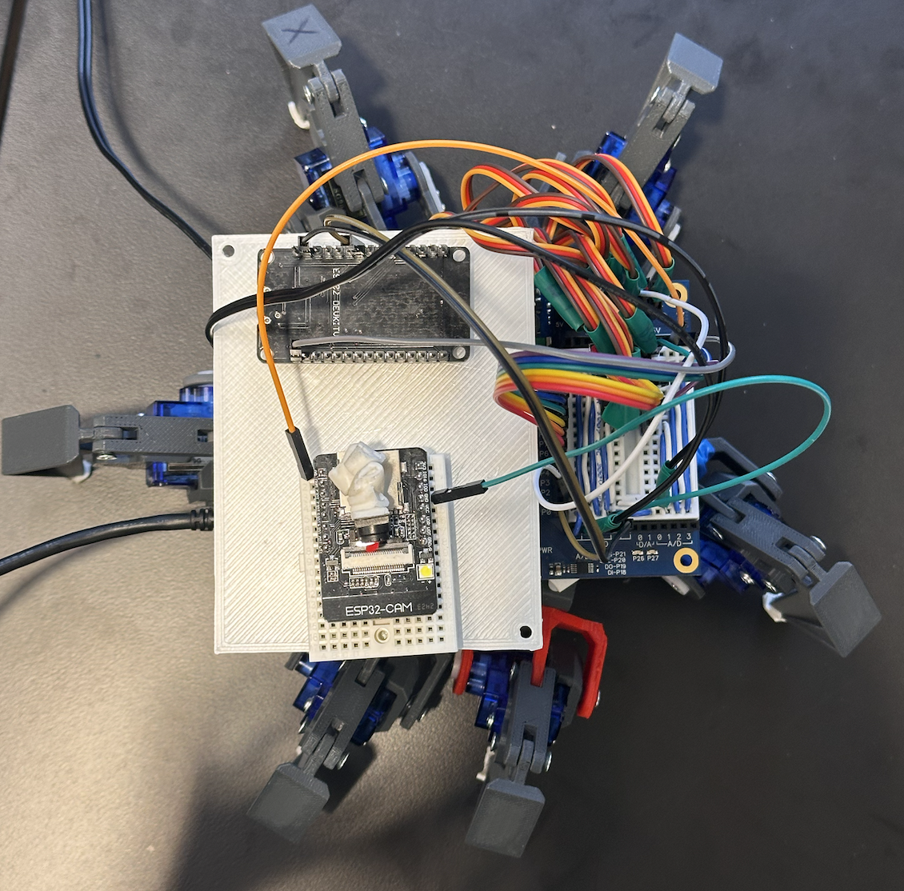
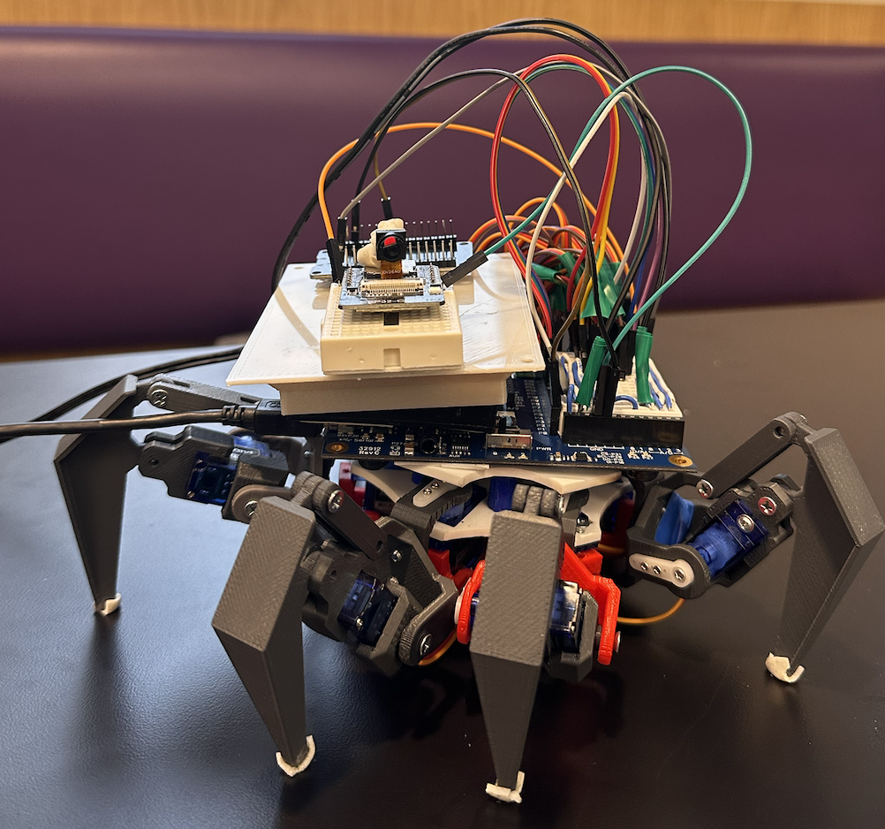
Final set up

Slide 18
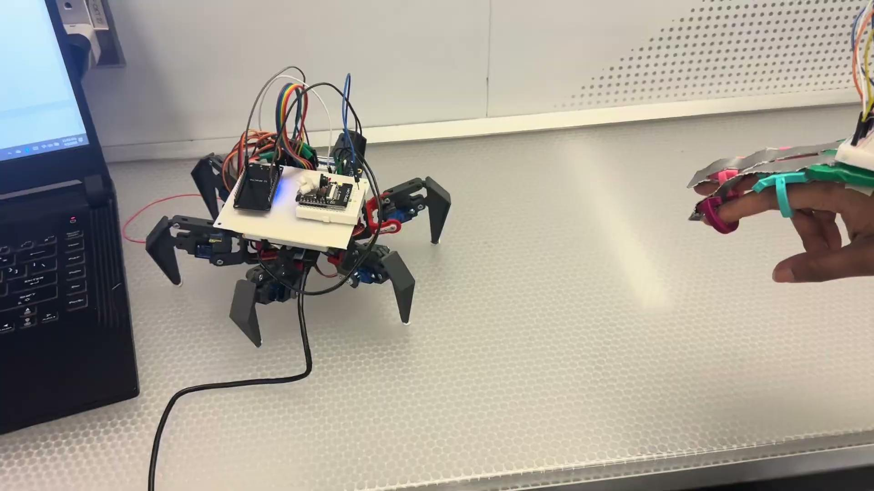
Prototype

Slide 19
Practical Overview

Slide 20
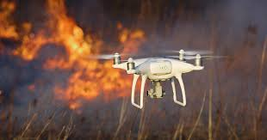
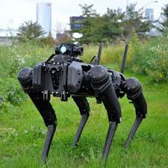
Related work
Several research efforts have been dedicated to enhancing search and rescue (SAR) operations through robotic innovations:
Autonomous Aerial Robots: Drones equipped with advanced algorithms can autonomously navigate disaster zones, providing real-time data to first responders.
Soft Robotics: Flexible robots inspired by biological organisms can adapt to complex terrains, improving navigation in hazardous environments.
Collaborative Multi-Robot Systems: Teams of heterogeneous robots, including ground and aerial units, work together to enhance efficiency in SAR missions.
Bio-Inspired Design: Robots with features modeled after animal physiology, such as moose-inspired hooves, demonstrate improved mobility in challenging terrains.
These advancements aim to address the limitations of traditional SAR methods, offering improved safety and efficiency in disaster response.

Slide 21
Related Work
Gesture-Controlled Hexapods Using Wireless Technology
Employing devices like the ATOM ESP32 Pico and IMU modules to detect and interpret hand movements.
Intuitive Control: Gesture-based systems enable natural interaction with robots, reducing the learning curve for users.
Wireless Operation: The elimination of physical connections increases user mobility and operational flexibility.
Limitations such as susceptibility to signal interference.
Challenges in achieving precise gesture recognition have been reported, affecting system reliability and responsiveness.
Intel’s Gesture-Controlled Spiderbots
Controlled through wearable devices equipped with accelerometers and gyroscopes.
Seamless Integration: Wearable controllers provide an intuitive and ergonomic interface for real-time robot interaction.
Real-Time Responsiveness: The system ensures immediate execution of user commands, enhancing the overall experience.
Drawbacks include a limited gesture set, restricting the range of functionalities.
Potential latency in gesture recognition, which may compromise real-time performance.

Slide 22
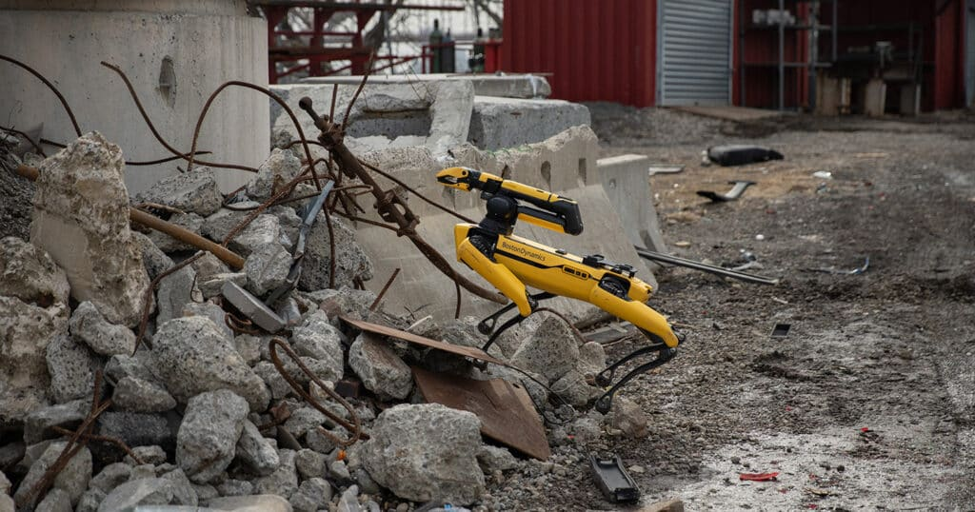
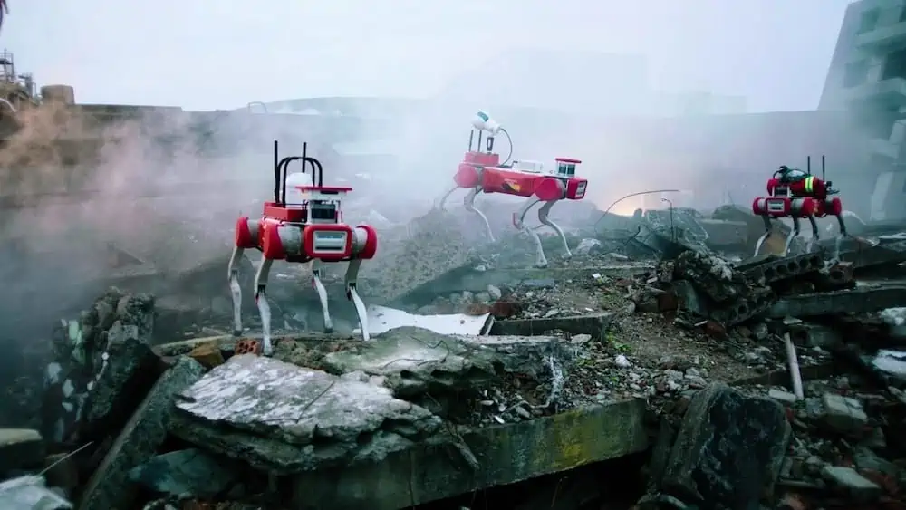

Applications
Innovative features and Unique selling proposition
Earthquakes
Floods
Wildfires
Industrial Accidents
Stability in rough terrain
Can reach places unreachable by humans
Wireless communication
User centric design with gesture based control

Slide 23
Cost analysis
Cost analysis for mass production
Cost component | Cost
Materials | $2,000
Actuators and sensors | $800
Manufacturing Labour | $500
Tooling | $100
Compliance and testing | $300
Marketing and distribution | $200
Shipping and Packaging | $100
Overhead | $300
Total | $4300
Component | Cost
Parallax propeller | $80
9g Servo motors | $45
3D print | $14
Flex sensors and IMU | $30
ESP32 with camera | $10
ESP32 Wroom 32 | $30
Miscellaneous | $15
Total prototype cost | $224
Bill of Materials

Slide 24
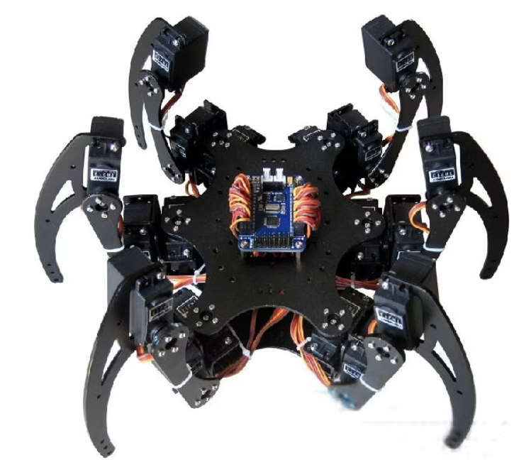
Next Steps
Make an 18 DOF hexapod for enhanced stability and added features
Incorporate more sensors for robot protection and rescue operations

Slide 25
Conclusion
Revolutionize Search and Rescue operations
Enhances disaster response
Scalable
Has versatile applications
User centric design with gesture based control
Challenging with respect to system complexity and energy efficiency

Slide 26
References
https://ieeexplore.ieee.org/document/10434325
https://amprius.com/rescue-robots/#:~:text=Ability%20to%20access%20hard-to,victims%20in%20otherwise%20unreachable%20places.
https://www.marketresearchfuture.com/reports/search-and-rescue-robots-market-10599#:~:text=Search%20and%20Rescue%20Robots%20Market%20Size%20was%20valued%20at%20USD,period%20(2024%20%2D%202030).
https://randomnerdtutorials.com/esp32-cam-video-streaming-face-recognition-arduino-ide/
https://ieeexplore.ieee.org/document/7041375
https://groups.csail.mit.edu/robotics-center/public_papers/Posa13.pdf
https://lastminuteengineers.com/esp32-basics-adc/#:~:text=force%2Dsensitive%20resistors.-,ESP32%20ADC%20Pins,15%20and%2025%20to%2027
https://www.circuits-diy.com/memsic-mx2125-accelerometer-with-arduino/
https://randomnerdtutorials.com/esp-now-esp32-arduino-ide/

Slide 27
Thank you.

